Slide 1
Sect 4.7 Using Identities to Solve Equations: Half Angle Identities
© Copyright all rights reserved to Homework depot: www.BCMath.ca

Slide 2
I) Half Angle Identities:

Slide 3
II) Proving Half Angle Identities:
The Half Angle identities are the easiest the prove and also the most useful
Just need the “Double Angle Identities”

Slide 4
Prove the following Identities:

Slide 5
Evaluate:

Slide 7
Given that $sin∅=\frac{3}{7}$, what is the exact value of :

Slide 8
III) Solving Trig Equations:
We can simplify a trig equation in this form to a single a trig function as a sum of two angles:
This can be used for solving equations that have sine , cosine and a constant
We will learn to convert the trig equation into a single trig function by using the sum/difference identities

Slide 9
Solving Equations in the form:
When given an equation in the form of Acos +Bsin =C, convert it to the form using the double angle properties
4th:Convert the EQ. to Rcos(+x)
First: Use the Sum/ Difference Identity
2nd:Solve for “R”
3rd:Solve for “x”

Slide 10
Solve for “” 0<  <360
1st Use the Sum/Diff. Identity to convert it to Rcos(+x) or Rsin(-x)
2nd : Solve for “R”
3rd : Solve for “x”
4th :Substitute into Rsin (-x)

Slide 11
Ex: Given each trig equation, indicate what substitution to make and solve for θ:

Slide 12
Ex: Given each trig equation, indicate what substitution to make and solve for θ:
You can use either one of these two:
Squaring & Combining the 2 eq above:
Slightly different if we solve for “b”
Now solve for “a”
Now solve for θ
Check you answers!!
Same answers!!

Slide 13
Ex: Given each trig equation, indicate what substitution to make and solve for θ:
You can use either one of these two:
Squaring & Combining the 2 eq above:
Again, we solve for “b”
“a” is in Q3
Now solve for θ
Same answers!!
Check you answers!!

Slide 14
This equation has no answers!
That’s because this value is greater than “R”
Start off by making a substitution
If we plug “R” back into the first equation, we get:
Suppose we have:
The range for this equation will be:
This ratio is bigger than 1, so there will be no answers!

Slide 15
Graph:
i) Find the maximum and minimum values and also the x-values when they occur
1st Use the Sum/Diff. Identity to convert it to Rcos(+x) or Rsin(-x)
The equation can now be written in the following form:

Slide 16
Plot the coordinates of the maximum points:
Then plot the minimum points:
Middle: X-intercepts
y
4
2
x
−3π
-450
-360
-270
-180
-90
0
90
180
270
360
450
540
-2
-4

Slide 17
Given:
Add the equations:
Subtract the equations:

Slide 18
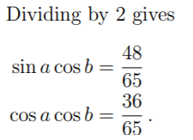
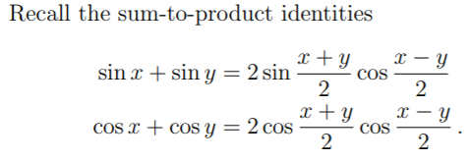
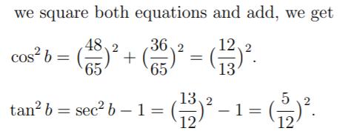
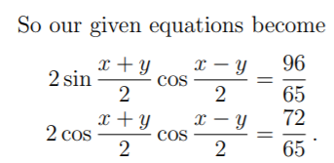
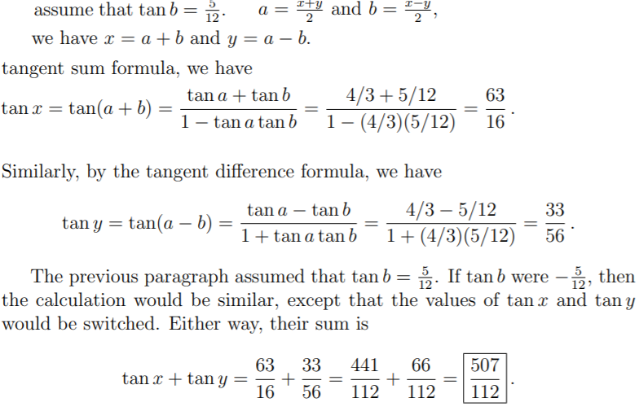
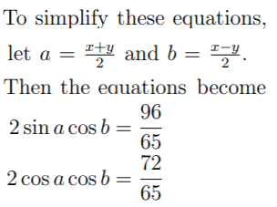
Math Prize for Girls 2014 507 / 112

Slide 19
Challenge: Prove
Sum Identities
Use the Double Angle Identities
for “sin2x” & “cos2x”
Expand/Distribute
Pythagorean Identity
Combine like-terms
© Copyright all rights reserved to Homework depot: www.BCMath.ca

Slide 21
Challenge: Find the exact value of

